Slide 1
CSS Summary
Week 2, Day 3

Slide 2
How to save HTML and CSS files in Sublime Text (1)
Let’s say you wrote your html code
But it’s gray!
Why?
Sublime doesn’t know we are writing html code

Slide 3
How to save HTML and CSS files in Sublime Text (2)
Let’s let Sublime know we’re writing html code
View -> Syntax -> HTML

Slide 4
How to save HTML and CSS files in Sublime Text (3)
Now it colors the code based on the syntax
Elements: Red
Attribute: Green
Strings or names: Yellow
Brackets and /: White

Slide 5
How to save HTML and CSS files in Sublime Text (4)
Make sure to save as html type in the same folder as the CSS file
Repeat the same steps for CSS files, but make sure to save as .css

Slide 6
What if I don’t have Sublime Text?
Can use any text editor like notepad
Just save in the name as ____.html (for html files) or ____.css (for css files)

Slide 7
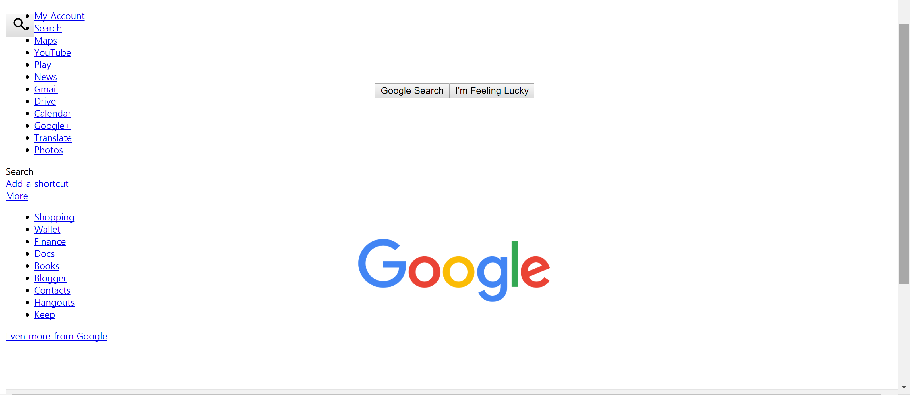
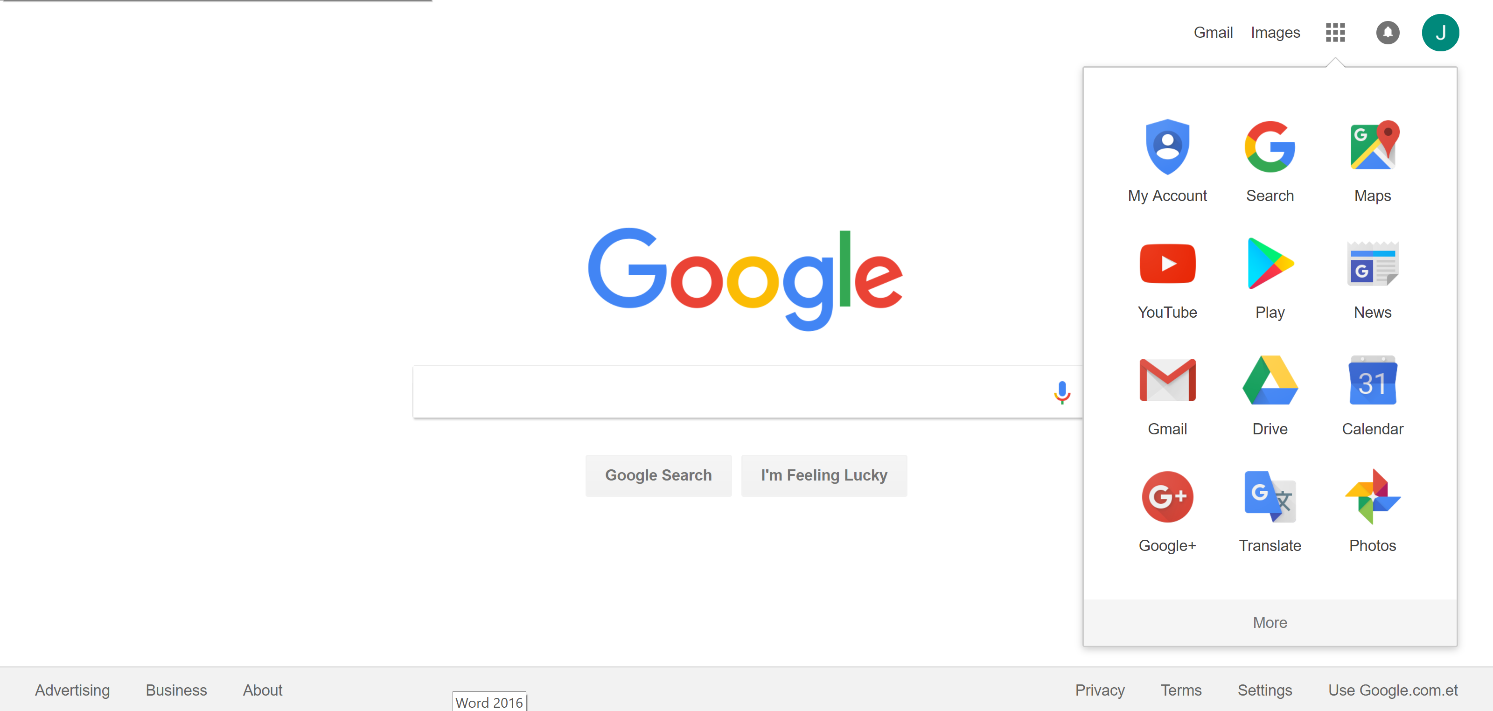
Functionalities: HTML and CSS
HTML (Hypertext Markup Language)
Defines structures
CSS (Cascading Style Sheets)
Gives styles to elements in structures

Slide 8
Review: HTML
Tag-based language that defines structure of web page
Elements
<h1> to <h6>, <p>, <a>, <img>, <ul>, <ol>, <table>, <iframe>, etc.
Attributes
<h1 name=”value”>

Slide 9
How to use CSS
Three different ways to define CSS styling:
Inline CSS: A single html element using style attribute
Internal CSS: CSS styling within the same html file
External CSS: CSS styling in a separate file (BEST)

Slide 10
1. Inline CSS
Defines style of a single HTML element
Uses the “style” attribute
<h1 style=”color:blue;”>hello</h1>
<p> style=”color:red;”>bye</p>
hello
bye

Slide 11
Style Attribute
<tagname style=”property:value;”>
Specifies the style of an element
Properties:
background-color
color
font-family
font-size
text-align

Slide 12
2. Internal CSS
Defines style of all elements of specific type in the same page as html
Need to use <style> element
CSS styling defined in the <style> element within <head>
Not preferred for most websites
<head>
<style> h1 {
color: blue;
} p {
color: red;
} </style> </head>
<body>
<h1>Hello World</h1>
<p>I’m Hubo!</p>
</body>

Slide 13
3. External CSS
Identical to internal CSS, except for the location of the CSS code
CSS styling defined in an external .css file and linked in HTML <head>
BEST practice for defining CSS!
Use external CSS whenever possible
HTML file:
<!DOCTYPE html>
<head> <link rel="stylesheet" type=“text/css” href="styles.css"> </head>
<body>
</body>
CSS file:
h1 {
color: blue;
}
p {
color: red;
}

Slide 14
How to link the HTML and CSS file
<link rel="stylesheet" type=“text/css” href="styles.css">
rel: relationship between html and css
type: type of document being linked
href: should indicate the path or the address to the css file (the css file name)

Slide 15
Syntax
Consists of selectors and declaration blocks
Selector: h1
Curly brackets
Each declaration consists of property and value
Property: color, font-size
Value: blue, 12px
Needs a semicolon at the end

Slide 16
Declarations
Pairs of properties and values
Properties:
background-color
color
font-family
font-size
text-align
and more
h1 {
color:blue;
font-size:12px;
}

Slide 17
Selectors
Allows CSS to locate the appropriate HTML elements
Four types of selectors:
Universal selector
Element selector
Id selector
Class selector
h1 {
color:blue;
font-size:12px;
}
h1 is an example of an element selector.

Slide 18
Review: Div Element
An empty container element
Useful for applying a specific styling for all elements within <div>
Extremely useful for organizing the css code
For example, put all headings together
<div style=”color:red;”>
…
</div>

Slide 19
Universal Selector
Selects every element from the webpage and applies the style
Uses *
* {
color: red;
}

Slide 20
Id Selectors
Finds HTML elements based on their “id” attribute
Each id should be unique in a page
Only one element with a particular id
No more than one id per element
HTML file:
...
<p id=”para1”>hello</p>
...
CSS file:
#para1 {
text-align:center;
color:red;
}

Slide 21
Class Selectors
Finds HTML elements based on their “class” attribute
Not unique
Multiple elements in a same class
Each element can be in multiple classes
HTML file:
...
<p class=”para2 para3”>hello</p>
...
CSS file:
.para2 {
text-align: center;
color: red;
}

Slide 22
Other Selector Specifications
Specifying HTML element types of a particular class
Grouping multiple selectors
p.center {
...
}
h1, h2, p.center {
...
}

Slide 23
Other Selector Specifications
Descendant selector (space): finds all the elements of specific type that are inside another specific type
Child selector (>), adjacent sibling selector (+), general sibling selector (~), etc.
div p {
...
}
This descendant selector (div p) selects all elements of type p that are inside div elements.

Slide 24
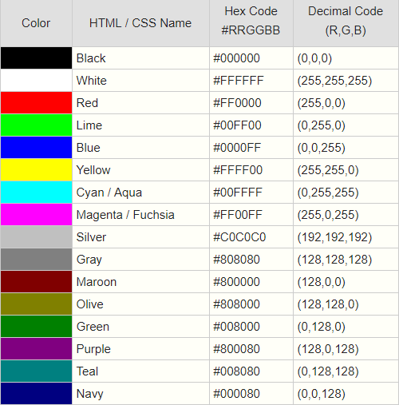
Colors
Different ways to represent color
Valid name: red
RGB value: rgb (255, 0, 0)
HEX value: #FF0000
h2 { background-color:#FF0000; color:rgb(255, 255, 255); }

Slide 25
Color (continued)
Background color: background only behind the element
Hue, Saturation, Lightness (HSL)
Hue: Color (0 – 360)
Saturation: Amount of gray in a color (%)
Lightness: Amount of white in a color (%)
Opacity
How transparent something is (0 – 1)

Slide 26
Fonts
Can change the type, size, bold, italics, spacing, etc
Relevant Properties:
font-family: typeface
font-size: size of the letter
line-height: space between each line
text-align: where the text goes (left, center, right)
word-spacing: space between each word
letter-spacing: space between each letter
font-style: italics, bold, etc

Slide 27
Fonts (continued)
font-family can have up to three values:
First value: the default typeface if the computer of the user has it
Second value: fallback
Third value: final fallback (usually serif or sans-serif)
If the typeface name is more than one word, use “ “
“Open Sans”
Google has many free typefaces you can use

Slide 28
Fonts measurements
Three types of font-size:
1. Pixels (px): number of pixels
2. Ems (em): relative to parent element
3. Percentage (%): relative the default size

Slide 29
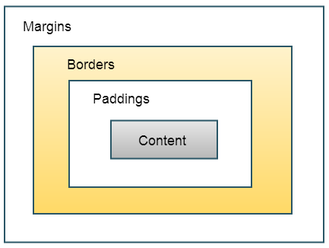
CSS Box Model
Relevant properties:
margin: thickness of the margin
border: style of the borders
padding: extra space
width: how wide the box is (px)
height: how tall the box is (px)
overflow

Slide 30
Why is CSS Box Model important?
There exists many different devices
All have different display sizes and measures
Use properties:
min-height: minimum px length of box
max-width: maximum px length of box
overflow: what happens if box is too big (scroll, hidden)

Slide 31
CSS Box Model
Properties width and height specifies the size of only the content
CSS file:
div { background-color: lightgrey; width: 300px; border: 25px solid green; padding: 25px; margin: 25px; }
HTML file:
...
<div>Hello</div>
...

Slide 32
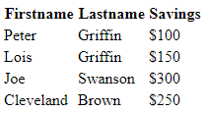
Example: Table
<table>
<tr> <th>Firstname</th> <th>Lastname</th> <th>Savings</th> </tr> <tr> <td>Peter</td> <td>Griffin</td> <td>$100</td> </tr> ... <tr> <td>Cleveland</td> <td>Brown</td> <td>$250</td> </tr>
</table>
Plain HTML table

Slide 33
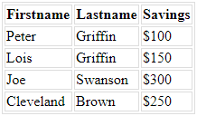
Example: Table
Add a border to the table and all its entries
Text-align all entries to the left
table, td, th { border: 1px solid #ddd; text-align: left; }

Slide 34
Example: Table
Collapse borders (combines two layers of borders into one)
Extend width to fill up the page (makes it more consistent and readable)
table, td, th { border: 1px solid #ddd; text-align: left; } table { border-collapse: collapse; width: 100%; }

Slide 35
Example: Table
Add padding to each entry to increase readability
table, td, th { border: 1px solid #ddd; text-align: left; } table { border-collapse: collapse; width: 100%; }
th, td { padding: 15px; }

Slide 36
Example: Table
table, td, th { border: 1px solid #ddd; text-align: left; } table { border-collapse: collapse; width: 100%;
}
th, td { padding: 15px; }
th {
background-color: #4CAF50; color: #FFFFFF; }
Add color variation to distinguish the header row

Slide 37
Example: Navigation Bar
Can be implemented as a list of links
Each html page has to exist!
<ul>
<li><a class="active" href="home.html">Home</a></li>
<li><a href="news.html">News</a></li> <li><a href="contact.html">Contact</a></li> <li><a href="about.html">About</a></li>
</ul>

Slide 38
Example: Navigation Bar
ul { list-style-type: none; margin: 0; padding: 0; overflow: hidden; border: 1px solid #e7e7e7; background-color: #f3f3f3; } li { float: left; } li a { display: block; color: #666; text-align: center; padding: 16px; text-decoration: none; } li a.active { color: white; background-color: #4CAF50; }
Zero margin and padding attaches the bar to the top edge of the page.
Left float allows all elements in the list to be contained in one line.
Block display allows you to click the entire area rather than just the text.
No text-decoration removes the color and underline of the links.
a.active indicates the tab you are on
Make sure to put the navigation bar into every html page to make it appear!

Slide 39
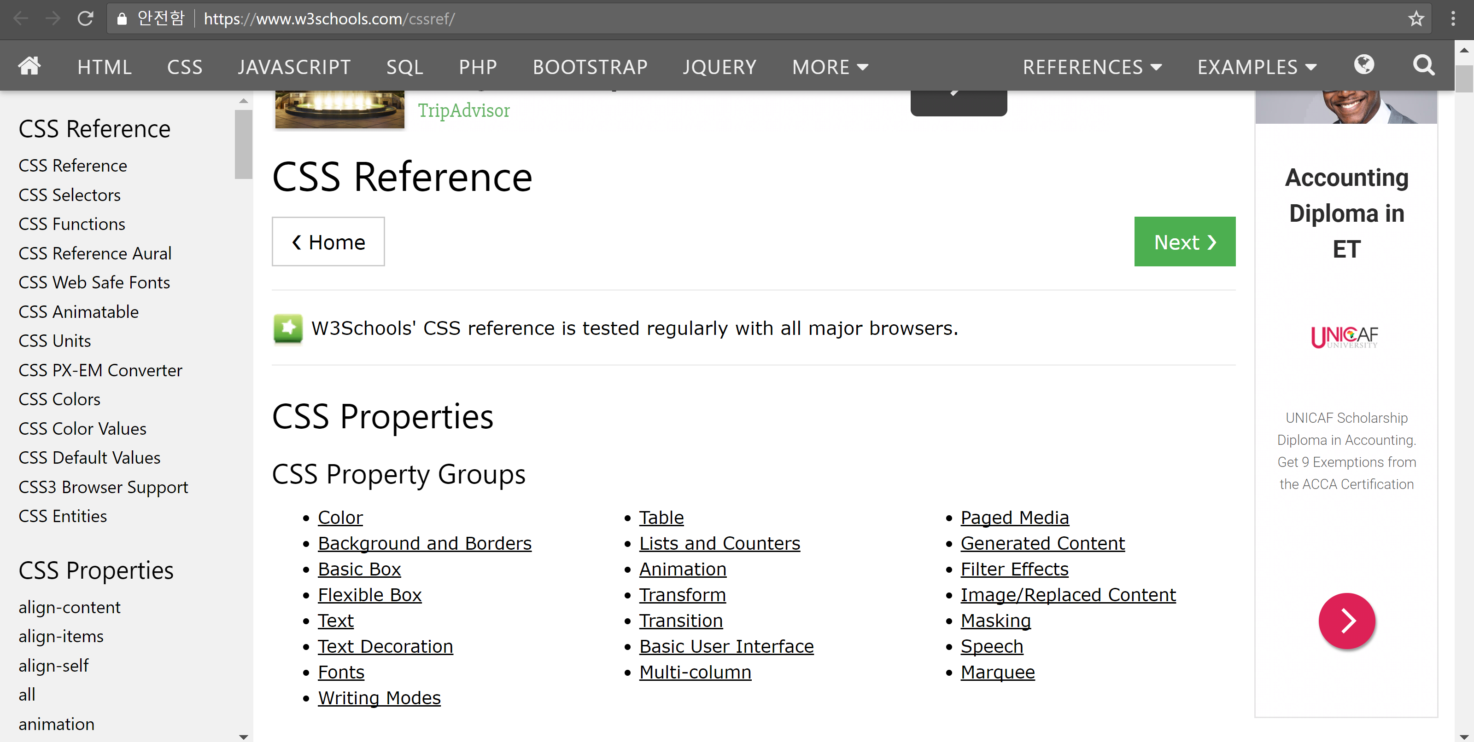
Good Tips
Add comments using /* and */
Search up necessary css properties and use them! It can make your website look really nice
Not everything can be done with html and css
https://www.w3schools.com/cssref/

Slide 40
JavaScript
Week 2, Day 3

Slide 41
Intro to JavaScript
JS is a programming language that enables dynamic changes to your HTML webpage
Basic syntax is similar to Python
Special syntax when referring to the objects in HTML
var x, y, z;
x = 5;
y = -5;
z = x + y;
document.getElementById('demo').innerHTML

Slide 42
Variables
Container for storing value
Naming rules:
Contain letters, digits, underscores, and dollar signs
Names cannot start with a digit
Names are case sensitive
Reserved words (if, else, while, etc.) cannot be used
Python:
x = 5
x = 3
JS:
var x = 5;
x = 3;

Slide 43
Variables
Declaration
tell the computer that x is now a variable
Assignment
tell the computer that x is now assigned with the value of 5
Declaration and assignment can be performed in one statement.
In Python, you did not have to explicitly declare variables.
var x;
x = 5;
var y = 4;

Slide 44
Data Types
Primitive data
Numbers
Strings
Booleans
Complex data
Functions
Objects

Slide 45
Data Types: Primitive Data
Numbers
Can perform operations such as +, -, *, /
Strings
Can use double or single quotation marks
Can perform concatenation operation +
Booleans
true or false
Can perform operations such as &&, ||, !
JS variables are type-dynamic.
Var x = 5 * 3;
x = “Hello world”;
x = true && !false;

Slide 46
Data Types: Functions
Two ways to define functions
Declaring the function as a variable means demofunc can only be used after the assignment
For the second method, demofunc can be used anywhere in the code
var demofunc = function(p1, p2) {
var answer = p1 * p2;
return answer;
}
function demofunc(p1, p2) {
var answer = p1 * p2;
return answer;
}
var x = demofunc(2, 3)
x = 6

Slide 47
Data Types: Objects
An object is a set of properties and methods
Each property and function is separated by comma
objectName.propertyName
objectName.methodName()
var hubo = {
x: 1,
direction: ”east”,
move: function() {
this.x += 1;
}
};
location = hubo.x;
hubo.move();
location = hubo.x;

Slide 48
Data Types: Objects
Properties can be modified outside of the object
var student1 = {
firstName: “Bob”
lastName: “Smith”
id: 123456789
fullName: function() {
return this.firstName + “ “ + this.lastName;
}
};
name = student1.fullName();
student1.firstName = “Robert”
name = student1.fullName();

Slide 49
Syntax
Semicolons at the end of every statement
Curly brackets { } around every code blocks (ex. function)
All JavaScript code can be written in one line.
Python:
def double(n):
answer = 2 * n
return answer
JavaScript:
function double(n) {
var answer = 2 * n;
return answer;
}
function double(n) {var answer = 2 * n; return answer;}

Slide 50
Conditionals
Another example of a code block
Small syntactic differences
Python:
if hubo.on_beeper():
hubo.pick_beeper()
hubo.move()
JavaScript:
if(hubo.on_beeper()) {
hubo.pick_beeper();
hubo.move();
}

Slide 51
While Loops
Another example of a code block
Small syntactic differences
Python:
while hubo.on_beeper():
hubo.pick_beeper()
JavaScript:
while(hubo.on_beeper()) {
hubo.pick_beeper();
}

Slide 52
For Loops
Another example of a code block
Small syntactic differences
Python:
sum = 0
for i in range(10):
sum += i
JavaScript:
var sum;
var i;
for(i = 0; i < 10; i++) {
sum += i;
}

Slide 53
JavaScript in HTML
Three different ways to place JavaScript code in HTML
Internal
External

Slide 54
Internal JavaScript
<head>
<style>
...
</style> <script> function demofunc() {
console.log(“hello”);
} </script>
</head>
<body>
...
</body>
Defines style of all elements of specific type in page
JavaScript code located in the “script” element within <head>

Slide 55
External JavaScript
Identical to internal CSS, except for the location of the CSS code
CSS styling defined in an external .css file and linked in HTML <head>
Best practice for defining CSS!
Use external CSS whenever possible
HTML file:
...
<head> <link rel="stylesheet" href="styles.css">
<script src="code.js"></script> </head>
...
code.js:
function demofunc() {
console.log(“hello”);
}

Slide 56
Output
Browser console
Alert
innerHTML
window.alert(“hello”);
console.log(“hello”);
document.getElementById(“id1”).innerHTML;

Slide 57
Output: Browser Console
Press “f12” in Chrome to access the console
Used for debugging (not for users)
var x = 5;
x += 2;
console.log(x);

Slide 58
Output: Alert
Creates a popup that alerts the users with a message
Not a good practice to use frequently
window.alert(“hello”);

Slide 59
Output: innerHTML
You can use JavaScript to read and change the contents of HTML elements
document.getElementById(“id_name”) obtains the object representing HTML element
innerHTML property gets the contents of the element
HTML:
<p id=“id1”>Hello, world<p>
JavaScript:
console.log(document.getElementById(“id1”));
document.getElementById(“id1”).innerHTML = Bye;

Slide 60
Events
User (or webpage) can create certain “events”
HTML can detect these events and use JavaScript to respond
<element event="some JavaScript">
Types of events
onchange, onclick, onmouseover, onmouseout, onload
<!DOCTYPE html>
<html>
<body>
<button onclick = "document.getElementById('demo').innerHTML = Date()">The time is?</button>
<p id="demo"></p>
</body>
</html>

Slide 61
Events
“this” refers to the current element
Inline JavaScript code usually calls a function (defined in a separate .js file) for simplicity
<h1 onmouseover = "change(this)">Hover mouse here</h1>
function change(ele) {
ele.innerHTML = “Thank you”;
}

Slide 62
Input
Many ways to get user’s input
“button” tag can detect click events
input element of type text accepts text input from user
input element of type radio allows users to choose between choices
<button>...</button>
<input type=“text”>...</input>
<input type=“radio” name=“gender”>male</input>
<input type=“radio” name=“gender”>female</input>
<input type=“radio” name=“gender”>other</input>
Notes:
checkbox text-input dropdown text-area

Slide 63
Lab
Alert the user when the web-page finishes loading
Hint: use the “onload” event on the body element
Create a div that changes between two colors depending on whether the mouse is hovered over it
Create a div that displays the number of times it was clicked on
Hint: Where should you define the counter variable (global)?

